Slide 1
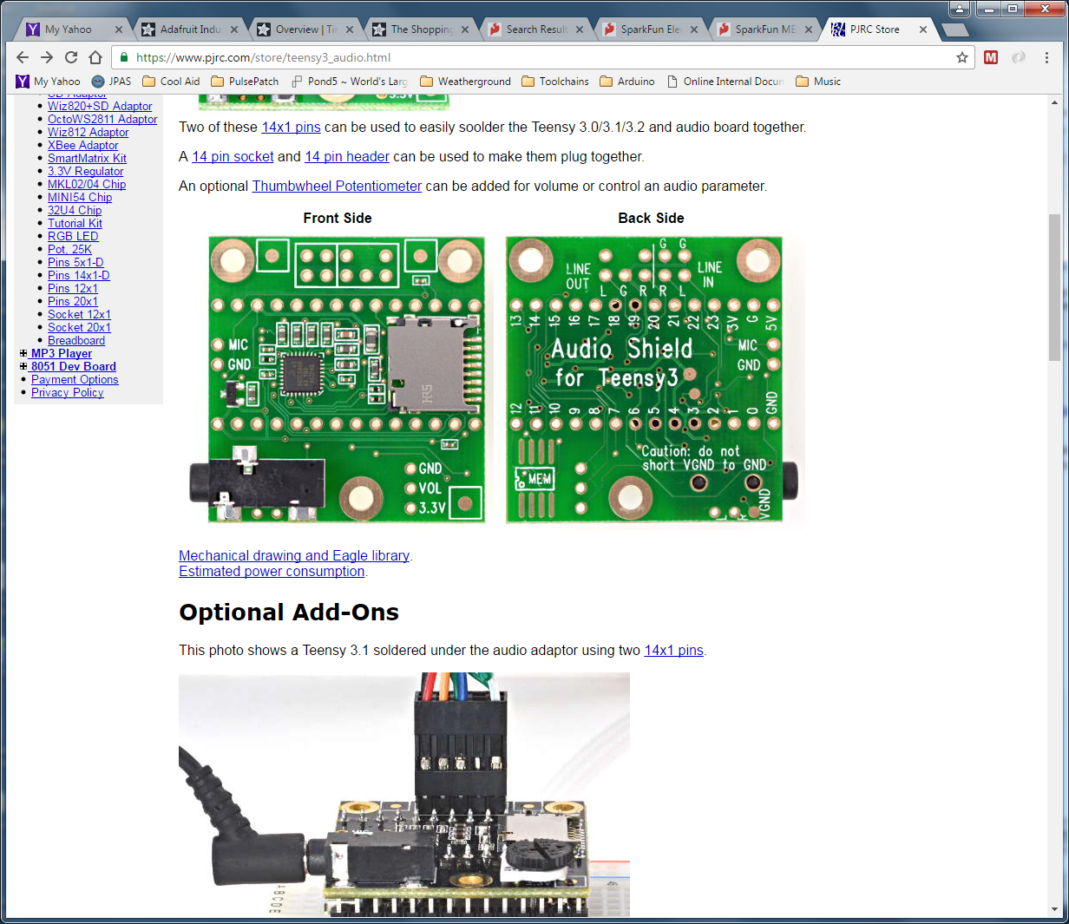
“Line In”
1/8” Phono Jack
Tip
Ring
Sleeve
“Mic In”
1/8” Phono Jack
Tip
Ring
Sleeve
Install Pot

Slide 2
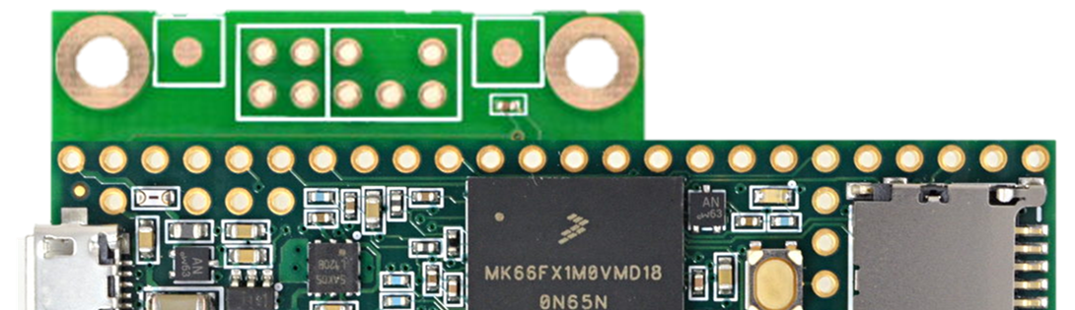
Also, grab “3V” and bring out to pin or to wire
Backside View
Add Header (Male Pins?)
To the “Line In”

Slide 3
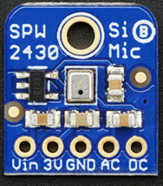
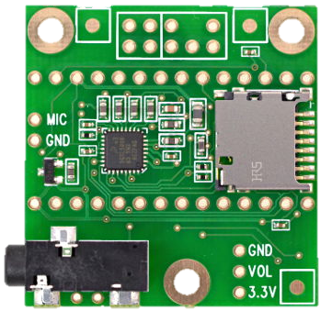

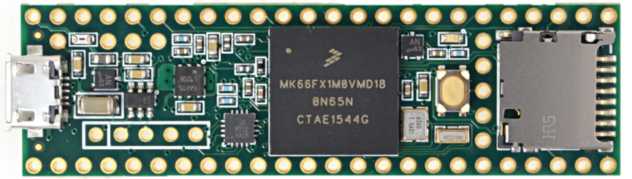
Mount Mic to the plastic base
Mount Mic to the plastic base
Mating
header
Mating
header
The new
header
Left
Right
To “Vin”
Not “3V”
Another “3V”
Wire
The “3V”
Wire
This is the plastic baseboard

Slide 4
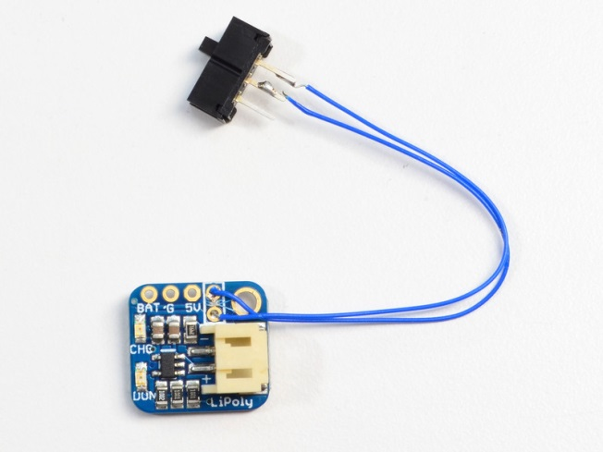
Adafruit 2124 LiPo Backpack
Power Supply
Add wires
Add a switch?
5V
Gnd
Vbat

Slide 5
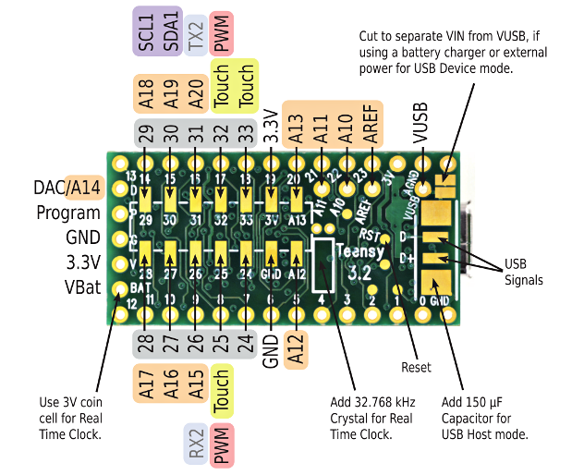
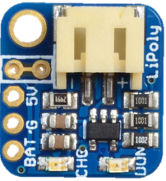
Cut this trace
Cut this trace

Slide 6
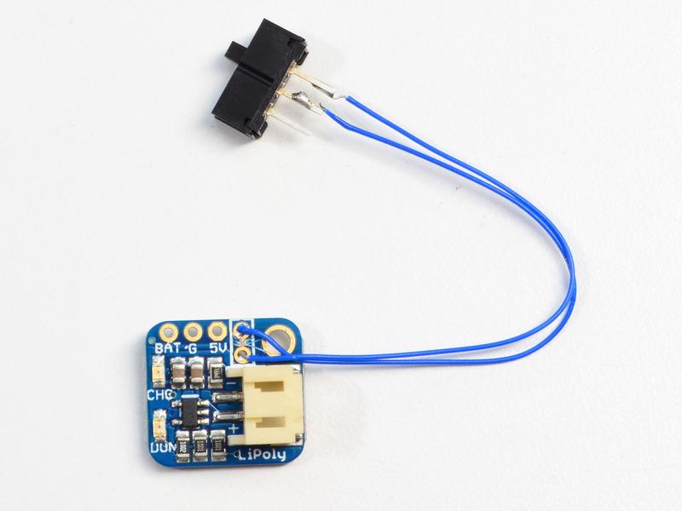
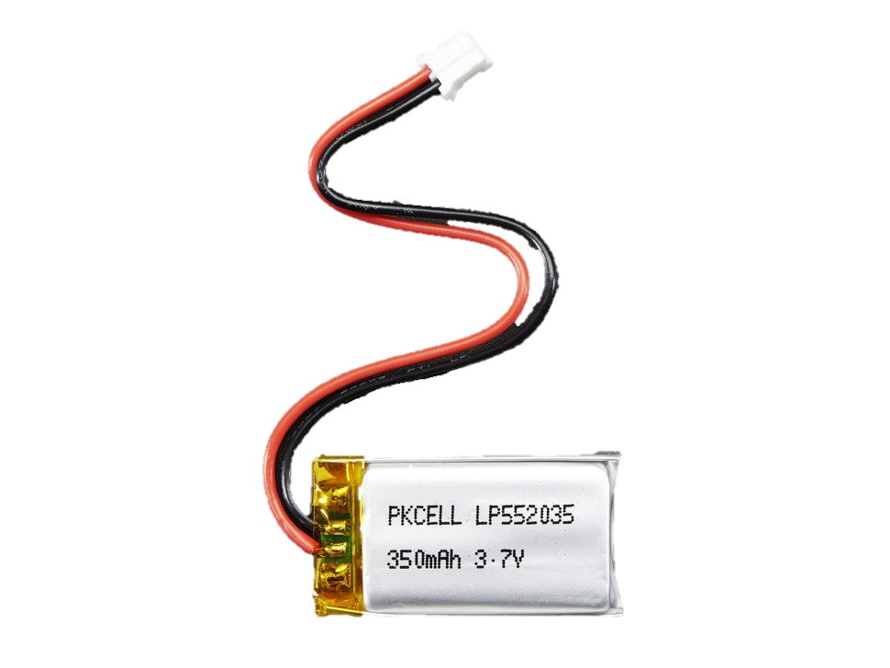
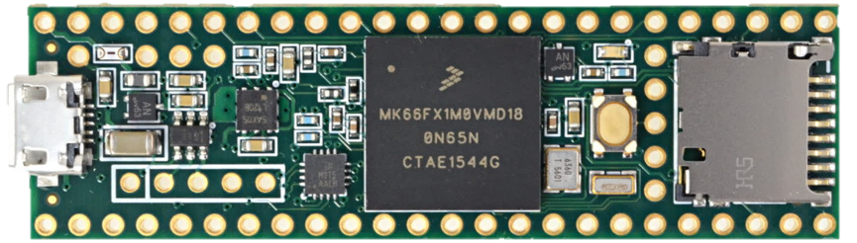
Some sort of switch.
Loose or panel mount.
Underneath, cut trace
Between V_{usb} and 5V
Tie Down?
(Holes + ZipTie?)
Screw this down.

Slide 7
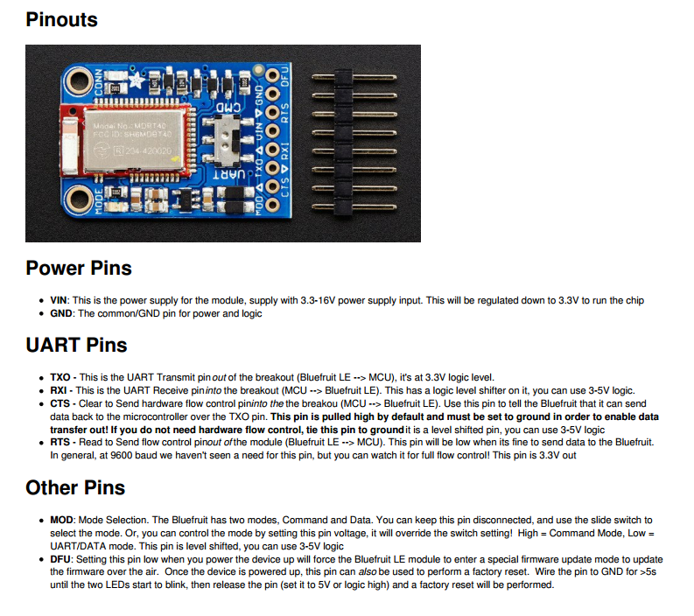

Slide 8
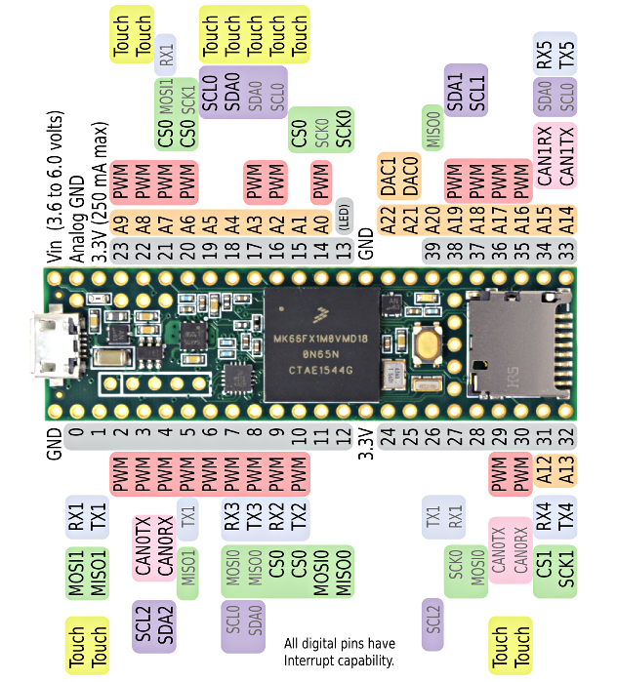
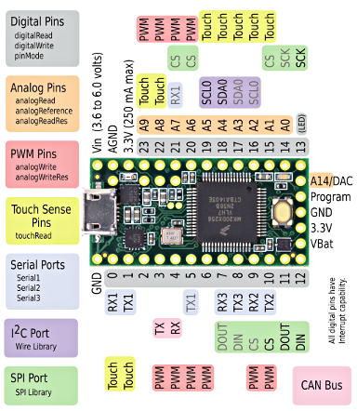
Teensy 3.2
Teensy 3.6

Slide 9
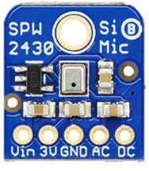

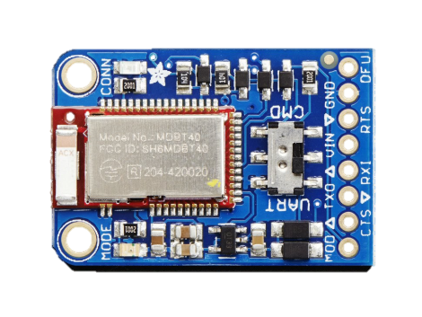
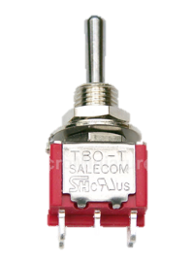
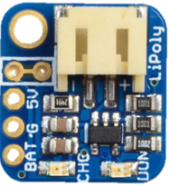
Try adding 3 pins.
Can the mics still mate?
Left
Right
??
3V
3V
Vbat
Pin Header
Connect all of these to the audio board, not the Teensy
Vbat
5V
Ground the CTS pin for TX out of the BLE unit.

Slide 10
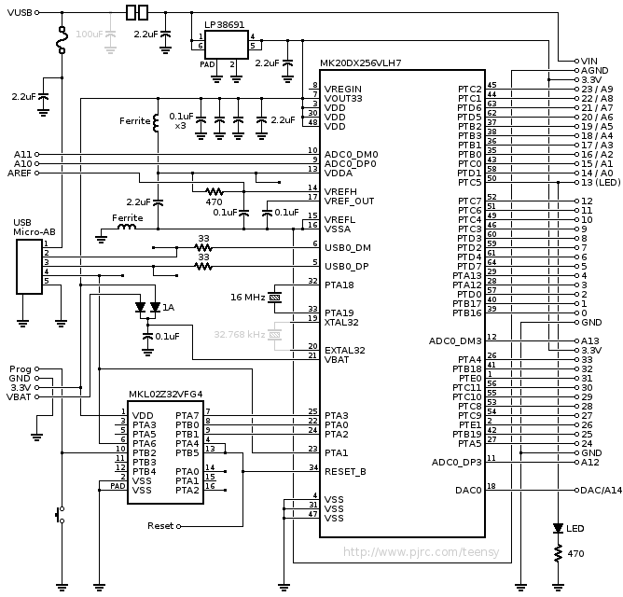
Teensy 3.2 Schematic
A pair of pads are linked to join VUSB to VIN. For applications where external power is needed, these pads may be cut apart to isolate the board's VIN power from VUSB.
A 32.768 kHz crystal (shown in gray) may be added to support the real time clock feature. A 100 uF capacitor (shown in gray) may be added for USB host applications, where power applied at VUSB or VIN is not capable of supplying inrush current to USB devices.
Teensy 3.1 added one signal, "DAC/A14", which was not present on Teensy 3.0. The reset signal moved from the right hand side to a test point on the bottom side. Other than this minor change, Teensy 3.0 and 3.1 are exactly the same schematic.

Slide 11
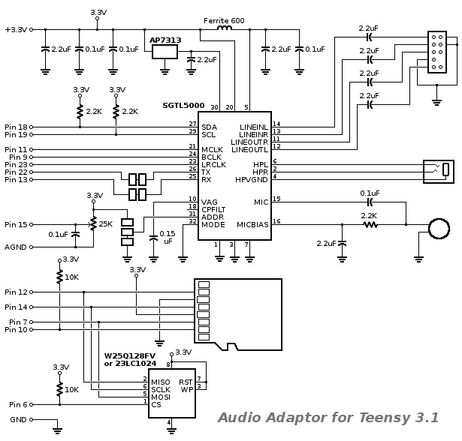
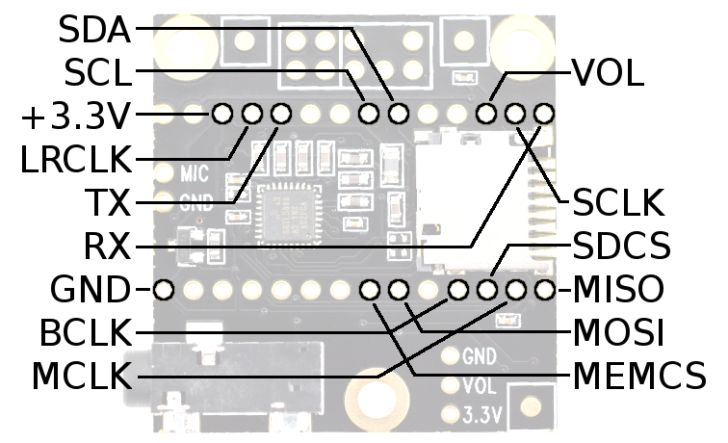
Audio Adaptor Board for Teensy 3.0 & 3.1 & 3.2
https://www.pjrc.com/store/teensy3_audio.html
Signals to Teensy
The audio chip, part number SGTL5000, connects to Teensy using 7 signals. The I2C pins SDA and SCL are used to control the chip and adjust parameters. Audio data uses I2S signals, TX (to headphones and/or line out) and RX (from line in or mic), and 3 clocks, LRCLK (44.1 kHz), BCLK (1.41 MHz) and MCLK (11.29 MHz). All 3 clocks are created by Teensy3. The SGTL5000 operates in "slave mode", where all its clock pins are inputs.
The line in/out header uses a pinout compatible with the AC97 audio header on PC motherboards. The front panel cables from most PCs can be connected, or wires can be soldered directly to the pins.
In January 2015, small improvements were added. The 1.0 µF capacitors were increased to 2.2 µF, to improve performance for sub-audible and extremely deep base sounds. 10K pullup resistors were added to pins 6 and 10.
Solder pads were added to the I2S transmit and receive lines, and the I2C address configuration pin. Teensy 3.1 & 3.2 are theoreticallycapable of quad channel I2S audio. These pads are intended to allow a second audio board to be used, for 4 channel audio input and output!

Slide 12
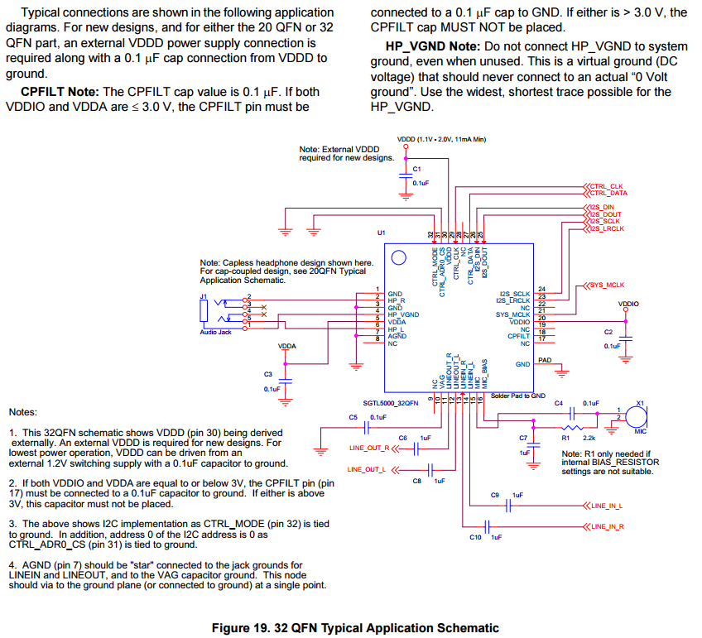
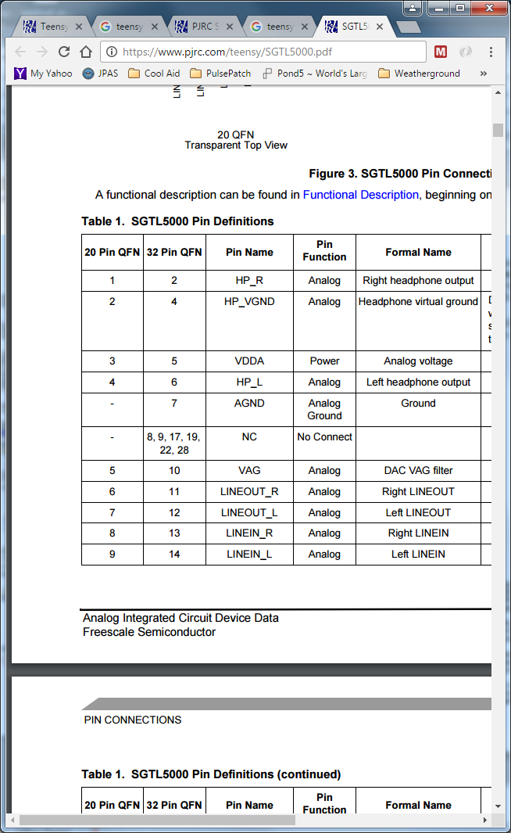
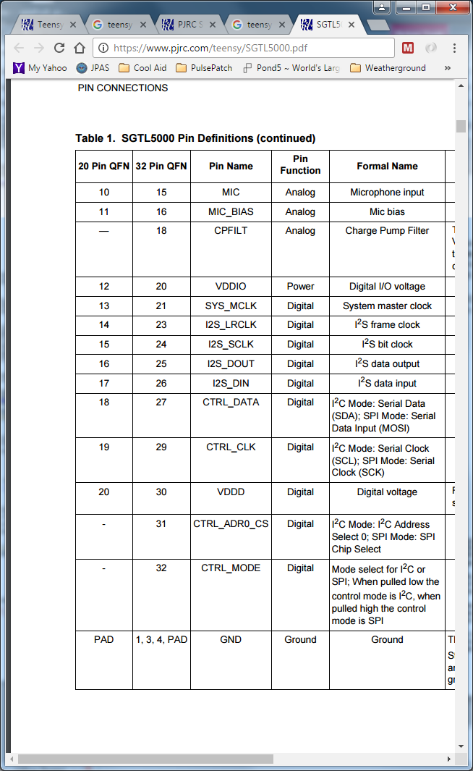
SGTL5000 Datasheet (Page 1)
https://www.pjrc.com/teensy/SGTL5000.pdf

Slide 13
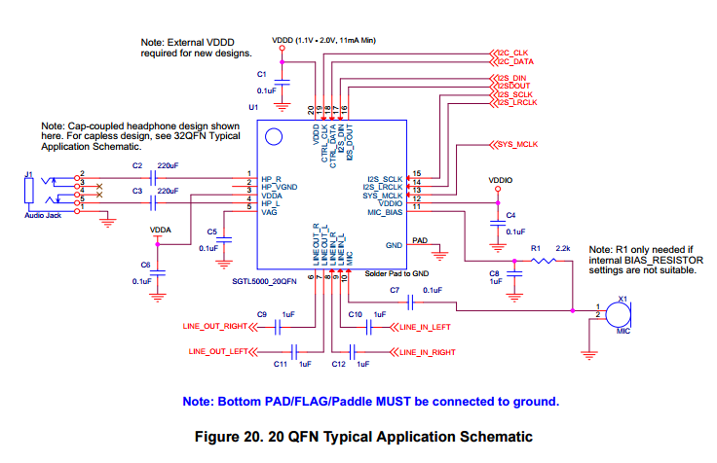
SGTL5000 Datasheet (Page 2)
https://www.pjrc.com/teensy/SGTL5000.pdf

Slide 14
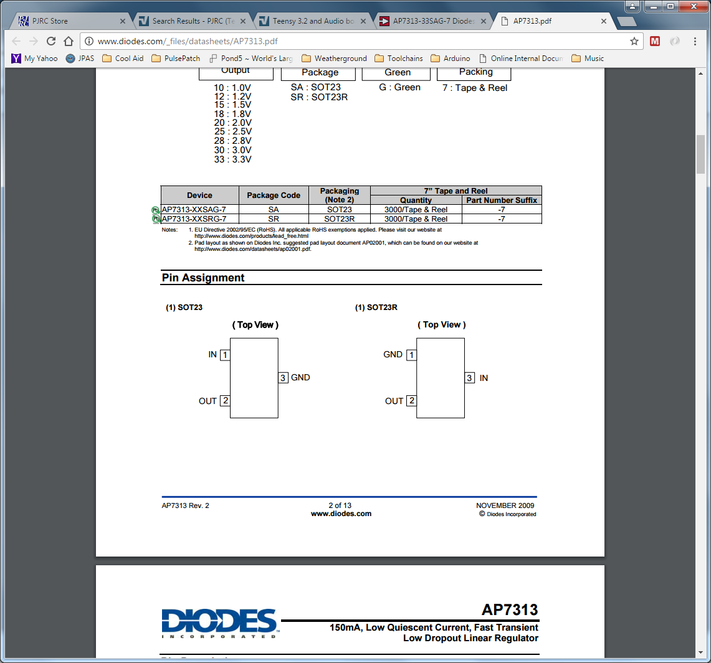
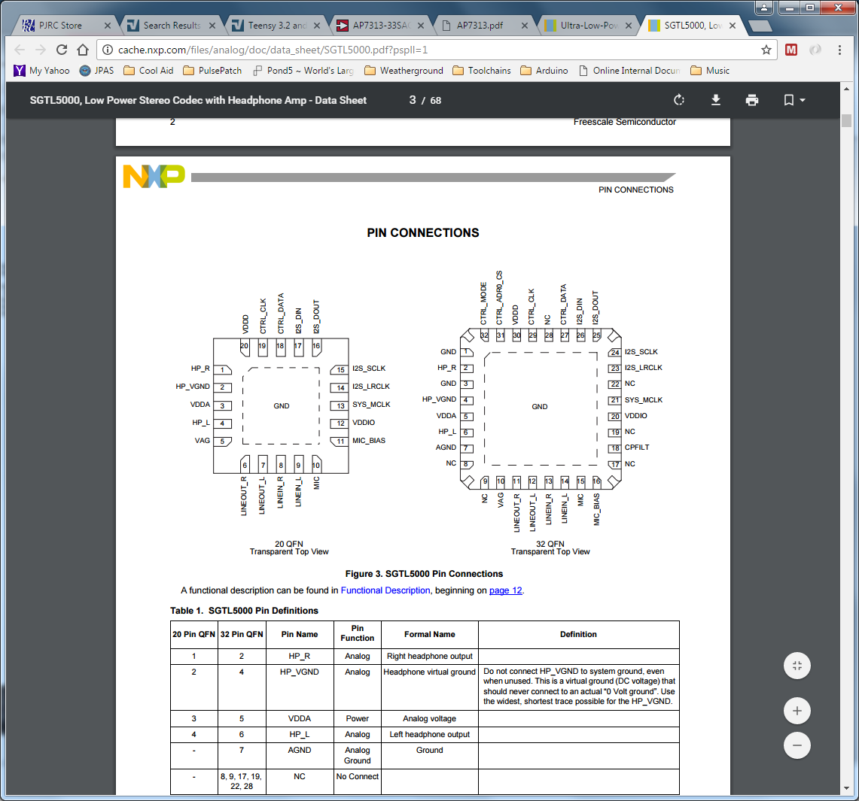

3V
GND

Slide 15
Ferrite?
Ferrite?

Slide 16
Audio Adaptor Board for Teensy 3.0 & 3.1 & 3.2
https://www.pjrc.com/store/teensy3_audio.html
Based on conversation with WHF, we should add 33ohm resistors to the digital comm lines. But how? It looks like the Pin 22 and Pin 13 (TX and RX for I2S) already have pads available. Lets try those first!
Add 33 Ohm
In-series?
Pads?

Slide 17
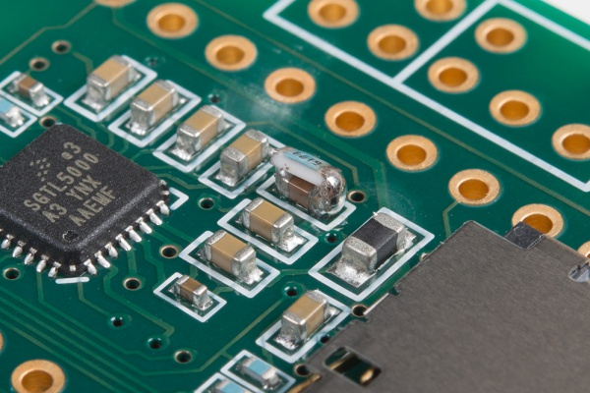
https://learn.sparkfun.com/tutorials/proto-pedal-example-programmable-digital-pedal?_ga=1.202107473.1503448100.1460730069
This step is optional, but has been found to help lower the noise floor of the Audio Adapter. Once the subassembly goes together, it is very hard to get access to the capacitor we're going to be modifying here.
As wen mentioned earlier, the Teensy Audio adapter has a rather high noise floor. On the PJRC forums, user omjanger has posted a modification that helps reduce the noise slightly. It involves putting a 1 MΩ resistor in parallel with the 0.15 uf capacitor on the VAG pin of the codec chip. This modification is shown below.
If you chose to undertake this modificaton, be warned: it takes an extremely careful touch to get the resistor in place without removing the capacitor entirely, or bridging adjacent components with solder blobs.

Slide 18
Female 0.1” Headers
1/8” Phono Jack
2.2K
Tip
2.2K
Ring
Sleeve

Slide 19
Try adding 3 pins.
Can the mics still mate?
Left
Right
3V
3V
Vbat
Pin Header
Connect all of these to the audio board, not the Teensy
Vbat
5V
Ground the CTS pin for TX out of the BLE unit.

